Slide 1
ES6 New topics
Arrow Functions
Promises
Classes
Maps, Set
Default Parameters
Template Literals
For loop
Block Scoped Variables

Slide 2
Arrow and Promise function helpful resources
http://www.javascriptkit.com/javatutors/javascriptarrowfunctions.shtml
https://www.sitepoint.com/es6-arrow-functions-new-fat-concise-syntax-javascript/
https://developer.mozilla.org/en-US/docs/Web/JavaScript/Reference/Functions/Arrow_functions

Slide 3
Arrow Functions
Arrow functions are a new ES6 syntax for writing JavaScript functions.
They will save developers time and simplify function scope.
Arrow functions make our code more concise, and simplify function scoping and the this keyword.
They are one-line mini functions which work much like Lambdas in other languages like C# or Python.
By using arrow function we avoid having to type the function keyword, return keyword (it’s implicit in arrow functions), and curly brackets.

Slide 4
Arrow Functions contd…
Basic Syntax
(param1, param2, …, paramN) => { statements }
(param1, param2, …, paramN) => expression
// equivalent to: function (param1, param2, …, paramN) => {return expression;}
// Parentheses are optional when there's only one parameter name: (singleParam) => { statements }
singleParam => { statements }
// A function with no parameters should be written with a pair of parentheses.
() => { statements }

Slide 5
Key Points
JavaScript arrow functions are anonymous functions
Arrow functions cannot be used as constructors as other functions can and will throw an error when used with new.
var Foo = () => {}; var foo = new Foo(); // throws an error
Arrow functions do not have a prototype property.
Prototype: Var foo = new Foo(); foo.prototype.count = 10

Slide 6
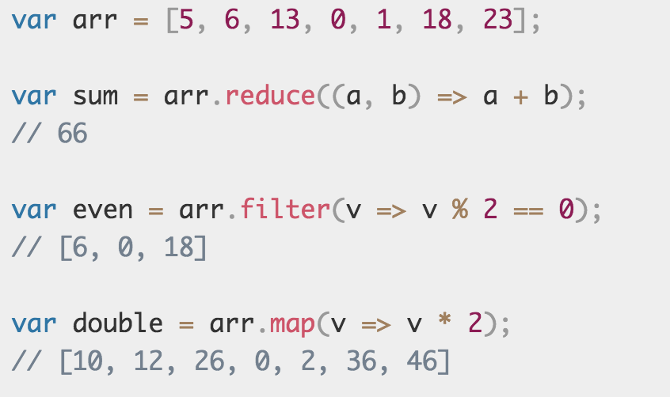
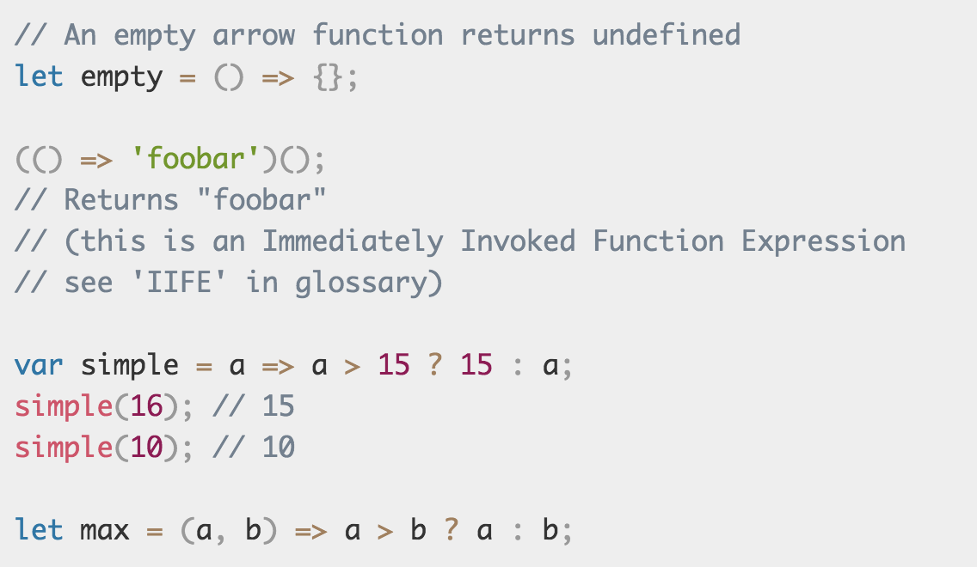
Examples
Normal Function:
function add(a , b) { return a + b; }
Arrow Function:
var add = (a, b) => a + b
Arrow Functions with array:
More Examples:

Slide 7
Promises
The Promise object represents the eventual completion (or failure) of an asynchronous operation, and its resulting value.
Promises can replace the asynchronous use of callbacks, and they provide several benefits over them
A Promise is a proxy for a value not necessarily known when the promise is created. It allows you to associate handlers with an asynchronous action's eventual success value or failure reason.
A Promise is in one of these states:
pending: initial state, neither fulfilled nor rejected.
fulfilled: meaning that the operation completed successfully.
rejected: meaning that the operation failed.

Slide 8
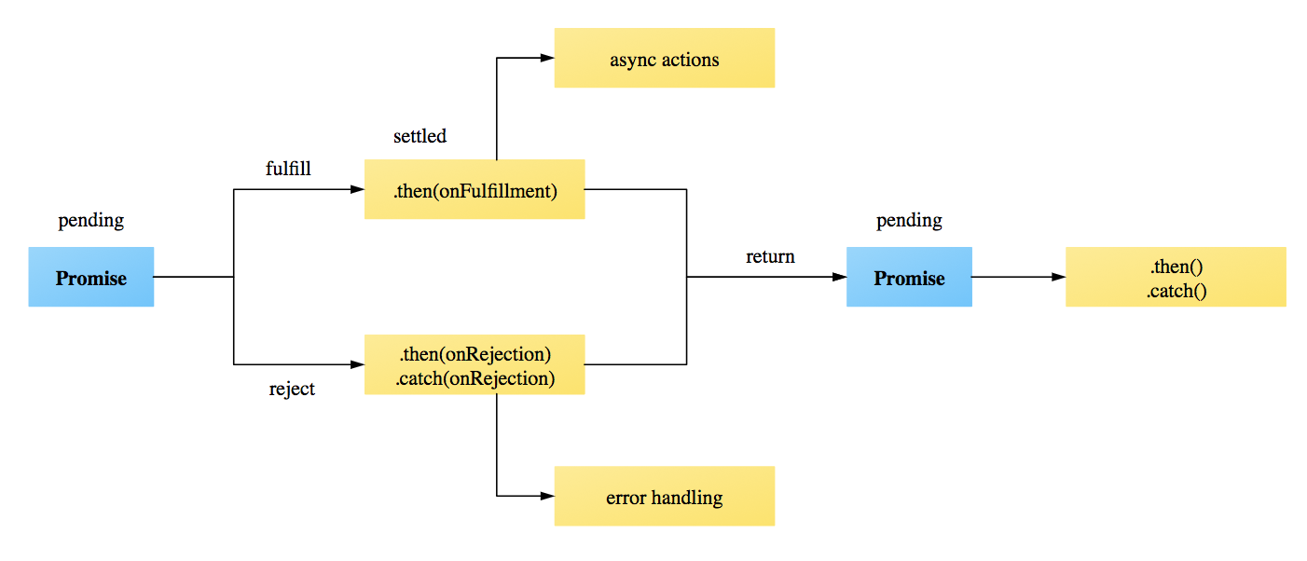
Promise contd…
Promises are a bit like event listeners except:
A promise can only succeed or fail once. It cannot succeed or fail twice, neither can it switch from success to failure or vice versa.
If a promise has succeeded or failed and you later add a success/failure callback, the correct callback will be called, even though the event took place earlier.

Slide 9
Creating Promises
The promise constructor takes one argument, a callback with two parameters, resolve and reject.
A Promise object is created using the new keyword and its constructor which takes as its argument a function called the "executor function".
The first of these functions (resolve) is called when the asynchronous task completes successfully and returns the results of the task as a value.
The second (reject) is called when the task fails, and returns the reason for failure, which is typically an error object.
Once settled, a promise can not be resettled. Calling resolve() or reject() again will have no effect.
Every promise has a .then() method which takes two arguments, a callback for a success case, and another for the failure case. It returns the promise object.

Slide 10
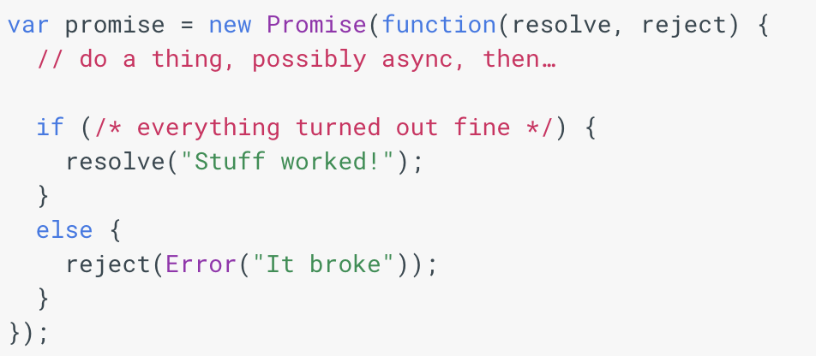
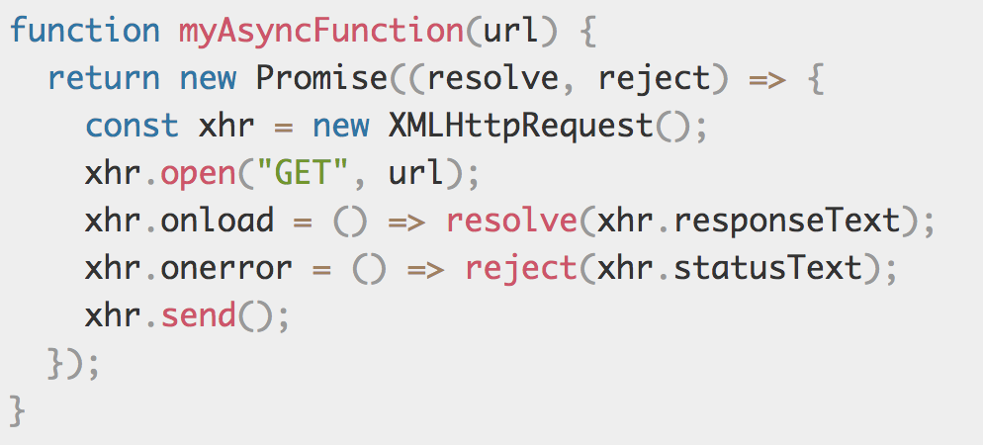
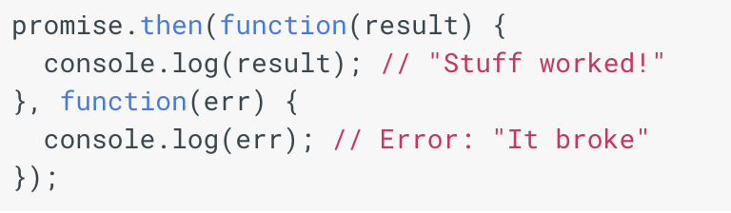
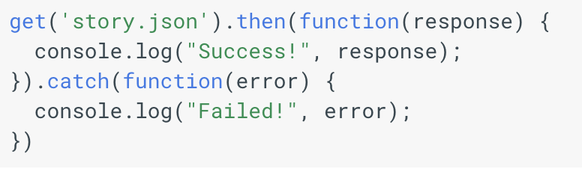
Syntax and examples
Creating a promise object :
Function with promise functionality :
.then() function of promise object :
catch() can also be used inside then()

Slide 11
Classes
ES6 support classes which has prototype-based inheritance, super calls, instance and static methods and constructors
class Foo {
constructor(x) {
this.x = x;
this.y = 432;
}
point() {
return 'Foo(' + this.x + ', ' + this.y + ')';
}
}
let myfoo = new Foo(99);
console.log(myfoo.point());
Output: Foo(99, 432)

Slide 12
Default Parameters in ES6
we can put the default values in the signature of the functions
//ES 5
var link = function (height, color, url) {
var height = height || 50
var color = color || 'red'
var url = url || 'http://azat.co'
}
//ES 6
var link = function(height = 50, color = 'red', url = 'http://azat.co') {
}
function multiply(a = 1, b = 2) {
return a * b;
}
console.log(multiply(5, 2));// Expected output:10
console.log(multiply(undefined,5));//Expected output: 5
Console.log(multiply(5)); // Expected output: 10

Slide 13
Maps, Set
Data structures for common algorithms.
// Sets
var s = new Set();
s.add("hello").add("goodbye").add("hello");
s.size === 2;
s.has("hello") === true;
// Maps
var m = new Map();
m.set("hello", 42);
m.set(s, 34);
m.get(s) == 34;

Slide 14
Template Literals
New syntax ${NAME} has been introduced in ES6
var first = "First Name";
var last = "Last Name";
//ES 5
var name = 'Your name is ' + first + ' ' + last + '.'
var url = 'http://localhost:3000/api/messages/' + name
//ES 6
var name = `Your name is ${first} ${last}.`
var url = `http://localhost:3000/api/messages/${name}`

Slide 15
For loop
//ES 5
var arr = ['a', 'b', 'c'];
for (var i=0; i<arr.length; i++) {
var elem = arr[i];
console.log(elem);
}
//ES 6
const arr = ['a', 'b', 'c'];
for (const elem of arr) {
console.log(elem);
}

Slide 16
Block Scoped Variables
“var” is function scoped, but not block scoped
“let” and “const” variables are block-scoped. Their scopes are the innermost enclosing blocks.
“let” is roughly a block-scoped version of “var”
“const” works like let, but creates variables whose values can’t be changed

Slide 17
// var is function-scoped or globally scoped
function varExample() {
if (true) {
var varVariable = 'I am var';
}
console.log(varVariable); // varVariable is accessible here
}
varExample();
// let and const are block-scoped
function letConstExample() {
if (true) {
let letVariable = 'I am let';
const constVariable = 'I am const';
{ console.log(letVariable, constVariable) // accessible
}
}
// console.log(letVariable); // Error: letVariable is not defined
// console.log(constVariable); // Error: constVariable is not defined
}
letConstExample();

Slide 18
Example
//ES 5
var p = 0;
if (true) {
var p = 1;
}
console.log(p); -> 0
var test = 10;
test = 11; -> No error
//ES 6
let j = 0;
if (true) {
let j = 1;
}
console.log(j); -> 0
const test = 10;
test = 11; -> Error

